Slide 1


URITECT INC.
From a photo to a finished space.
AI that lets anyone see a renovation before it begins, then shop it and hire the people to build it.
U.S. Funder & Investor Session · October 21, 2026
Notes:
Introduce Uritect: a Canadian company at the University of Toronto building AI products for the built world. Our flagship is Archibi.

Slide 2
THE PROBLEM
Every renovation starts with a guess
01
02
03
Hard to picture
Scattered steps
Costly to get wrong
Most people cannot see a finished room in an empty one, so big decisions are made on faith.
Inspiration, furniture and contractors live in different places, with nothing connecting them.
Design fees, wrong purchases and rework all arrive before anyone sees the result.
Notes:
The renovation journey is fragmented: imagining, buying and hiring are three different worlds.

Slide 3
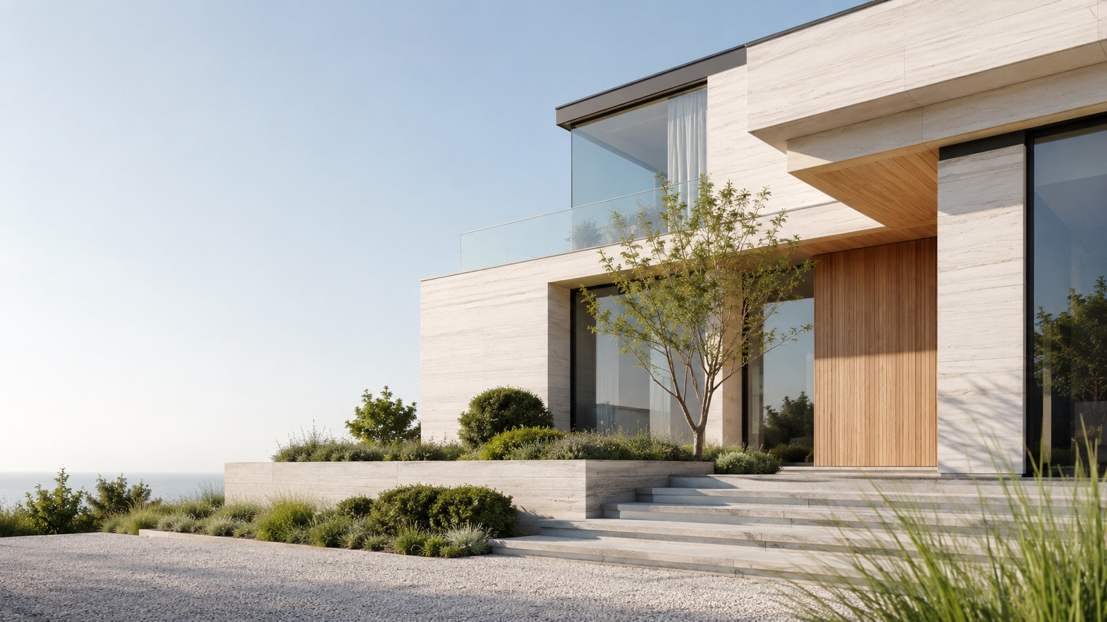
OUR ANSWER
Archibi: one app from idea to renovation
1
Design
Snap a room, a façade or a garden, choose a style, and see it redesigned in seconds.
2
Shop
Archibi recognises the furniture in a photo and finds similar pieces to buy, with prices and stores.
3
Hire
Share the design with vetted architects, designers and contractors, and contact them in one tap.
Notes:
Archibi is live on the App Store and Google Play. Design, shop and hire happen in one place.

Slide 4
THE PRODUCT TODAY
A complete design studio in your pocket
5
75+
100+
100+
design tools
design styles
furniture stores
curated ideas
Interior, Exterior, Landscape, Sketch to Render, Find Furniture
Two modes: Beautiful for careful updates, Creative for bold change
Behind the Furniture Finder's shoppable matches
In the Idea Bank, across interiors, exteriors and gardens
Plus colour palettes, materials for walls, floors, ceilings, façades and paths, saved projects, favourites, and sign-in with email, Google or Apple.
Notes:
Everything on this slide is shipping today in Archibi on iOS and Android.

Slide 5

TWO-SIDED BY DESIGN
Find Pro turns designs into real projects
For clients
For professionals
Browse professionals by section, category and speciality
See their story, tags and project gallery
Save favourites and make contact in one tap
Apply at pro.archibi.ca with portfolio, CV and documents
Every profile is reviewed by our team before going live
Manage profile and projects from one dashboard
Notes:
Every Archibi design ends with the question 'who can build this?'. Find Pro answers it, and gives us the supply side of a renovation marketplace.

Slide 6
BUSINESS MODEL
Freemium subscriptions, built to grow
FREE
PLUS
PRO
ENTERPRISE
$0
$6.99/mo
$29.99/mo
Custom
5 welcome renders
90 renders a month
450 renders a month
Shared render pools
Try every core tool
or $59.99 a year · HD, no watermark
or $249.99 a year · 4K, commercial rights, priority
Teams, seats, custom styles, integrations
Plus render top-up packs, sold through the App Store, Google Play and card. Prices as published on archibi.ca/pricing.
Notes:
Revenue today comes from subscriptions and top-ups. Find Pro is free for professionals while we build supply.

Slide 7

THE OPPORTUNITY
A market that renovates every day
Who Archibi serves
$519B
Homeowners and renters
Real estate professionals preparing listings
Interior designers and architects
Projected annual U.S. homeowner spending on improvements and repairs
Contractors looking for qualified clients
Source: Harvard Joint Center for Housing Studies, Leading Indicator of Remodeling Activity, July 2026 release.
Design and architecture students
Notes:
Archibi sits at the very start of this spending: the moment of deciding what to do.

Slide 8
THE URITECT ECOSYSTEM
Many front doors, one platform
FLAGSHIP
MARKETPLACE
SERVICE
3D DESIGN
Archibi AI
Archibi Find Pro
Brightment
Utect 3D
Design, shop and hire from a photo
Profiles for architects, designers, contractors
AI concepts and installed basement egress windows
Homes and rooms in the browser (Alpha)
WELLBEING
EDUCATION
MEDIA
MEDIA
Blink20
Arch School
ArchNews
CanadaTechNews
Free 20-20-20 eye breaks on 5 platforms
Free design workshops for women
Architecture and construction stories
Canada's technology ecosystem
Notes:
Education and media build audience and trust; the design apps convert it; services and professionals turn designs into revenue.

Slide 9
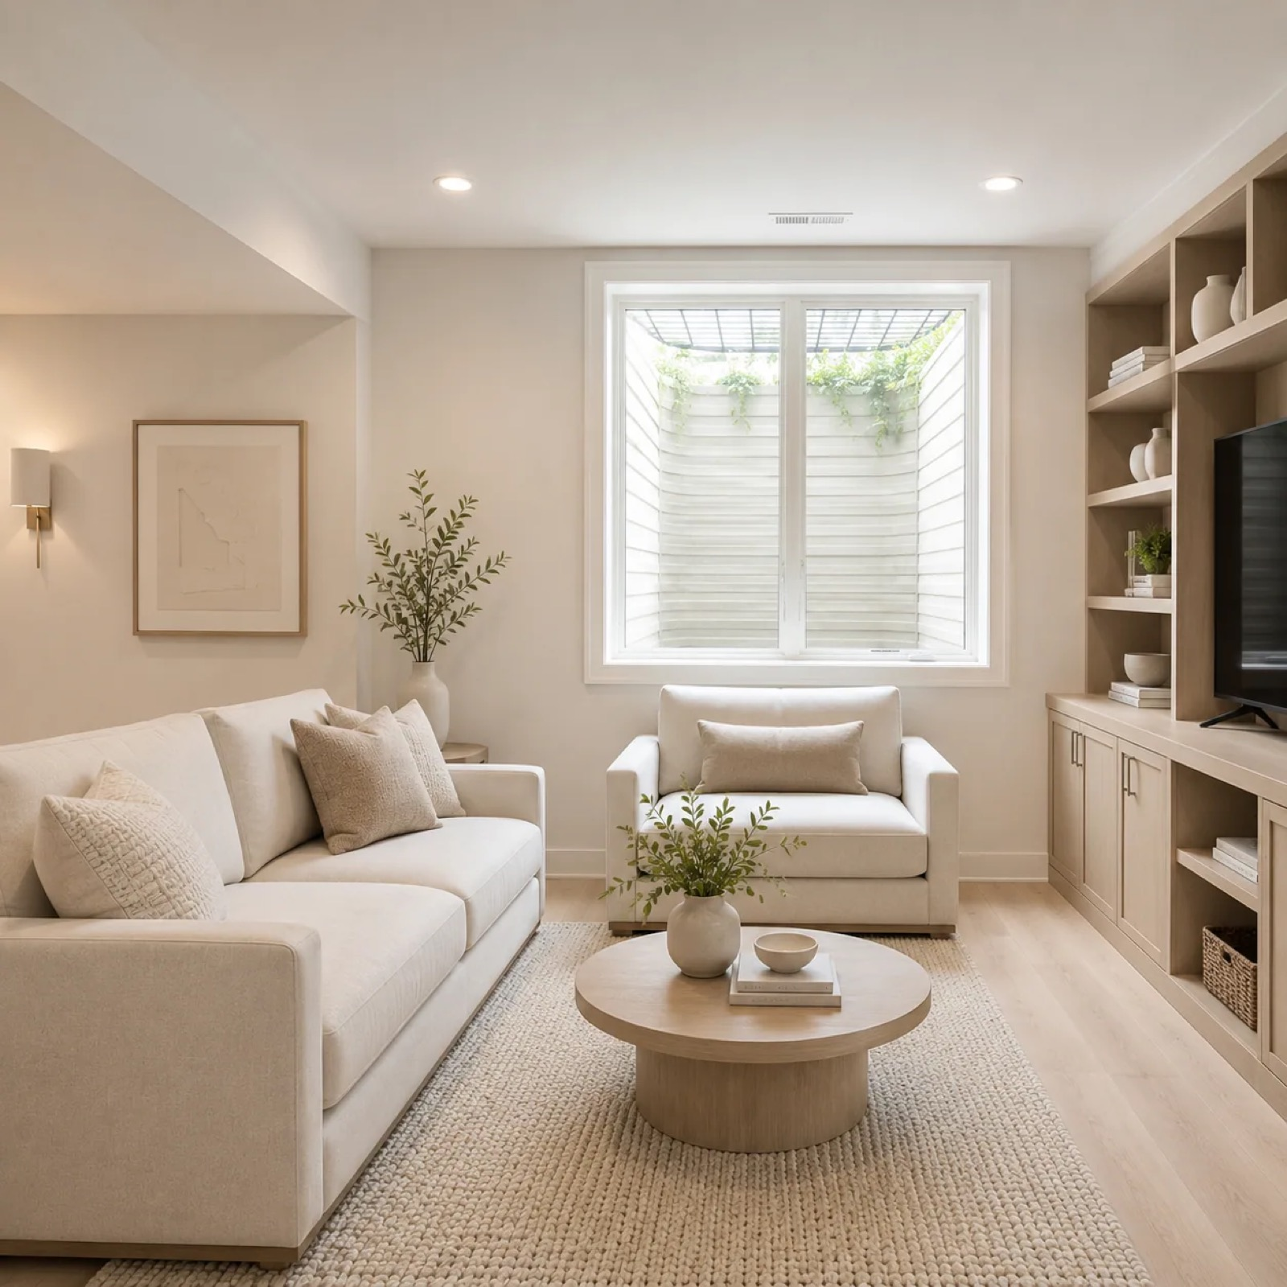
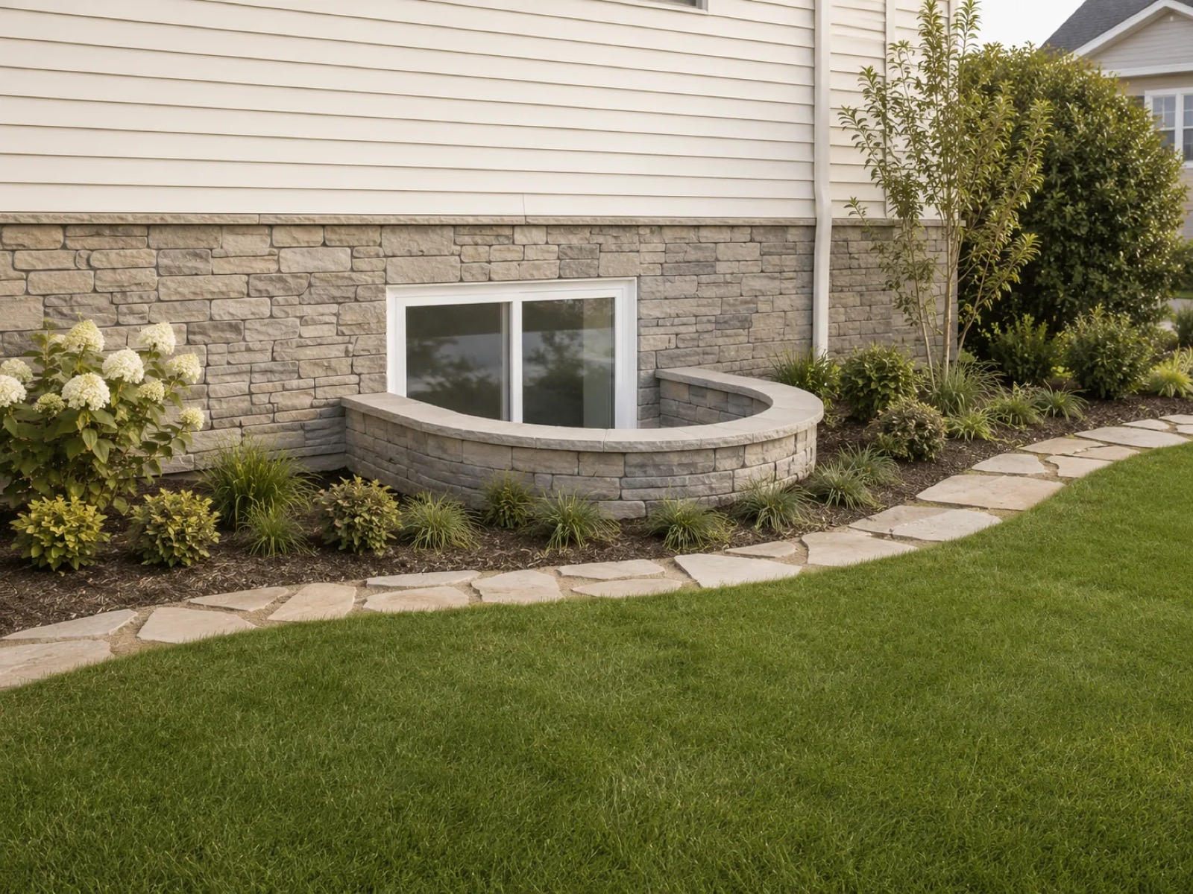
PROOF OF THE MODEL
Brightment: from AI concept to paid installation
See it first
Photograph a basement window and see a realistic egress window, window well and landscaping.
One team
Design, permits, excavation and installation, most finished in a single day.
Easy to say yes
$0 down with monthly instalments through a financing partner, subject to approval.
Notes:
Brightment shows how a free AI concept app can lead directly to a high-value service job. It is live on the App Store and Google Play.

Slide 10
WHERE WE ARE
Built, shipped and growing
2024
Opened our Richmond Hill office; took part in CIX 2024 and DiscoveryX 2024
2025
Joined U of T's innovation hub at the Schwartz Reisman Innovation Campus
2026
Archibi AI live on the App Store and Google Play
2026
Find Pro professionals portal live at pro.archibi.ca
2026
Brightment app live on iOS and Android
2026
Blink20 live on iOS, Android, macOS, Windows and Linux, in 21 languages
Notes:
Add current downloads, active users and revenue here before presenting.

Slide 11
THE TEAM
Architecture and AI under one roof
Hamidreza Zandi
CEO & Founder
Masoumeh Shoar
COO & Co-Founder
Dr. Shahla Zandi
CPO · product, design and marketing
Abtin Zandi
CTO · development and AI
HZ
MS
SZ
AZ
Mouhamad Mouhamad Hoseini
Back-end Developer
Sarvin Nami
Android Developer
Alireza Zare
Front-end Developer
Arshia Hashemianzadeh
AI Developer (Intern)
MM
SN
AZ
AH
Women hold founding and key roles. Supported by Pycap Inc. and U of T Entrepreneurship.
Notes:
A team that understands buildings and builds AI: we design for how renovations really happen.

Slide 12

OUR ASK
Partner with us to bring Archibi to the U.S.
01
02
03
Capital
Partners
Professionals
To grow Archibi's U.S. user base and scale the AI that powers it.
Furniture retailers, real estate and building brands to plug into Design, Shop and Hire.
Introductions to U.S. architects, designers and contractors for Find Pro.
Notes:
State the raise amount and use of funds here.

Slide 13

Thank you
Let's design the future of the built world together.
Uritect Inc. · uritect.com · archibi.ca
University of Toronto, Schwartz Reisman Innovation Campus
108 College St., Suite W754, Toronto, ON, Canada · (437) 800-0845
Notes:
Open for questions.

